Slide 1
Chapter 4: Exploratory Research
© 2018 Cengage Learning. All Rights Reserved.

Slide 2
Learning Objectives (1 of 3)
Describe the basic uses of exploratory research.
Specify the key characteristics of exploratory research. Small scale and very flexible studies are used to generate ideas and insights.

Slide 3
Learning Objectives (2 of 3)
Discuss the various types of exploratory research and describe each.
Identify the key person in a focus group.

Slide 4
Learning Objectives (3 of 3)
Discuss two major pitfalls to avoid with focus groups (or any other form of exploratory research).

Slide 5
Exploratory Research (1 of 4)
Research conducted to gain ideas and insights to better define the problem or opportunity confronting a manager.

Slide 6
Exploratory Research (2 of 4)
When conducted correctly, exploratory research should provide a better understanding of the situation and possibly yield hypotheses—but this kind of research is not designed to come up with final answers and decisions.

Slide 7
Hypothesis
HYPOTHESIS
A statement that specifies how two or more measurable variables are related.
Some examples:
(H1): Women are more likely than men to make impulse purchases of our brand.
(H2): Decreasing price by 10% will increase unit sales by 30%.
(H3): Adoption of our new product will be greater in Northern states than in Southern States.

Slide 8
Why conduct exploratory research?
Develop hypotheses
Better formulate the manager’s decision problem
Increase researcher’s familiarity with the problem
Clarify concepts

Slide 9
Exploratory Research (3 of 4)
Small scale
Flexible
Anything (reasonable) goes!

Slide 10
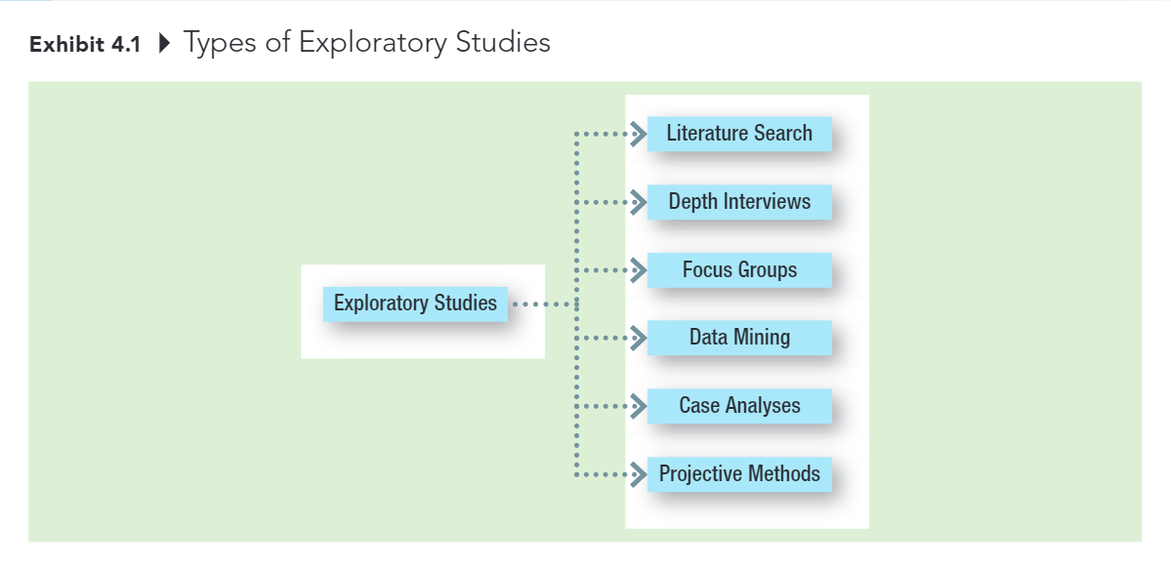
Exploratory Research (4 of 4)

Slide 11
Literature Search
A search of statistics, trade journal articles, other articles, magazines, newspapers, books, and/or online sources for data or insight into the problem at hand.

Slide 12
Depth Interviews
Interviews with people knowledgeable about the general subject being investigated.
Some possibilities:
those who work with it (for example, employees, consultants)
those who study it (for example, researchers, analysts)
those who live it (for example, consumers)

Slide 13
Focus Group (1 of 2)
An interview conducted among a small number of individuals simultaneously; the interview relies more on group discussion than on directed questions to generate data.

Slide 14
Characteristics of Focus Groups
Typically 8 to 12 people
1.5 to 2 hours in length
Homogeneous within group; heterogeneity introduced across groups
Participants carefully screened
Sessions recorded and transcribed

Slide 15
Traditional focus groups Versus Online focus groups

Slide 16
Focus Group (2 of 2)
MODERATOR
The individual that meets with focus group participants and guides the session.
MODERATOR’S GUIDEBOOK
An ordered list of the general (and specific) issues to be addressed during a focus group; the issues normally should move from general to specific.

Slide 17
Seven Characteristics of Good Focus Group Moderators (1 of 2)
Superior listening ability
Excellent short-term auditory memory
Well organized
A quick learner
Source: Thomas L. Greenbaum, The Handbook for Focus Group Research, 2nd ed. (Thousand Oaks, Calif.: Sage Publications, 1997), pp.77-78.

Slide 18
Seven Characteristics of Good Focus Group Moderators (2 of 2)
High energy level
Personable
Well-above-average intelligence
Source: Thomas L. Greenbaum, The Handbook for Focus Group Research, 2nd ed. (Thousand Oaks, Calif.: Sage Publications, 1997), pp.77-78.

Slide 19
The Dark Side of Focus Groups
It’s easy for managers to see what they expect to see in focus group results.
Focus groups are only one form of exploratory research—they should not be expected to deliver final results or answers to decision problems—yet many managers seem to use them for that purpose.
“Focus groups are the crack cocaine of market research. You get hooked on them, and you’re afraid to make a move without them.”

Slide 20
Normal Groups
NOMINAL GROUPS
A group interview technique that initially limits respondent interaction while attempting to maximize input from individual group members.

Slide 21
Data Mining (1 of 2)
The use of powerful analytic technologies to quickly and thoroughly explore mountains of data to obtain useful information.

Slide 22
Data Mining (2 of 2)
Although most forms of exploratory research are qualitative in nature, data mining involves sophisticated quantitative analysis of data held in a company’s databases.

Slide 23
Data Mining
1-800-flowers.com used data mining to develop successful promotions after discovering that professional, suburban moms were a key demographic for them.

Slide 24
Case Analyses (1 of 2)
Intensive study of selected examples of the phenomenon of interest.
Especially effective with cases reflecting...
...recent change
...extremes of behavior
...the “best” and “worst” situations

Slide 25
Case Analyses (2 of 2)
Aeropostale has used observations of its young customers at amusement parks, concerts, and lots of other locations to help select the clothes it carries in its stores.

Slide 26
Ethnography
ETHNOGRAPHY
The detailed observation of consumers during their ordinary daily lives using direct observations, interviews, and video and audio recordings.

Slide 27
Benchmarking
BENCHMARKING
Using organizations that excel at some function as sources of ideas for improvement.
Companies have long used L.L. Bean as a benchmark for order fulfillment efficiency.

Slide 28
Projective Methods
Methods that encourage respondents to reveal their own feelings, thoughts, and behaviors by shifting the focus away from the individual through the use of indirect tasks.

Slide 29
Types of Projective Methods
Word association
Sentence completion
Storytelling
Role playing

